Slide 1

New line of office stationery sales analysis and recommendations
Improving revenue through data-driven insights
Prepared by: Leonel Toro, Data Analyst

Slide 2
Business problem: Which sales method is most effective, and how can we optimize performance?
Analysis goals:
To measure the performance of each sales method
To define a metric for the company to monitor
To generate actionable recommendations to enhance revenue
This analysis focuses on understanding sales performance and identifying opportunities to optimize revenue generation for the new line of office stationery.

Slide 3





Overview of the Analytical Process
Sales Methods Comparison
Data Validation
Exploratory Analysis
Key Metrics Analysis
Recommendations
To ensure accuracy and consistency.
Converted data types.
Standardization.
Treated outliers values.
Identified key trends in revenue and sales method.
Assessed customer distribution across methods.
Visualized relationships between metrics.
Focused on revenue and customer count.
Identified top-performing groups
Established baseline metrics for evaluation.
Compared method based on performance metrics and over time.
Highlighted strengths and weaknesses for each method.
Suggested strategies to optimize sales based on insights.
Identified opportunities to enhance revenue.
Developed a monitoring plan with actionable metrics.

Slide 4
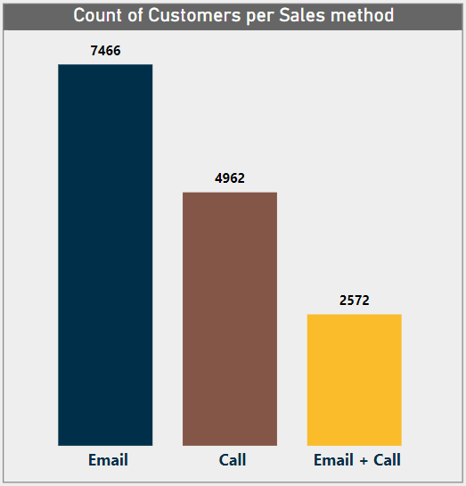
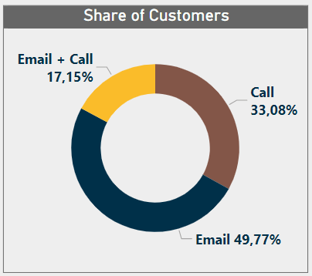
Number of Customers
This section analyzes the customer base by sales method to identify which approaches successfully attract a larger audience.
Data on the number of customers contacted through each method is unavailable, making it impossible to assess their effectiveness in closing sales.

Slide 5
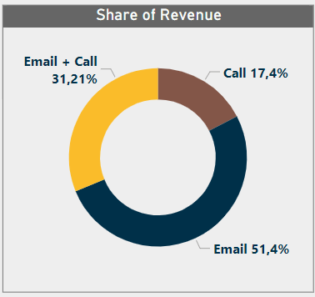
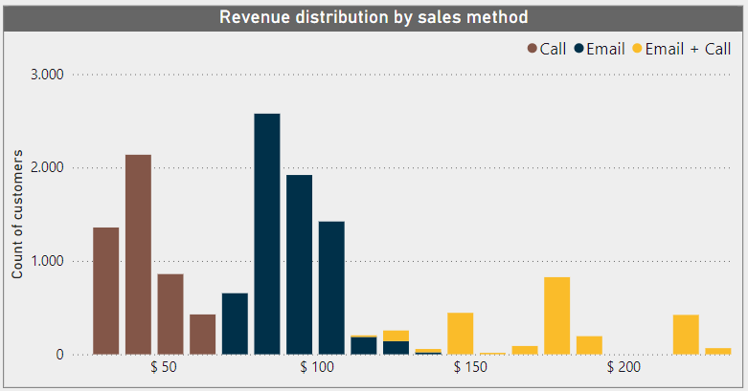
Revenue Spread and Distribution
Each sales method exhibits a specific range within the revenue distribution.
The Call’s and Email + Call’s revenue percentages are inversely proportional to the customer distribution percentages.
Adjusting the distribution of customers across sales methods could lead to revenue optimization.

Slide 6
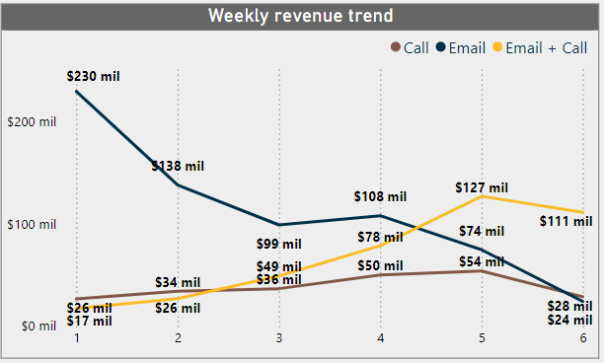
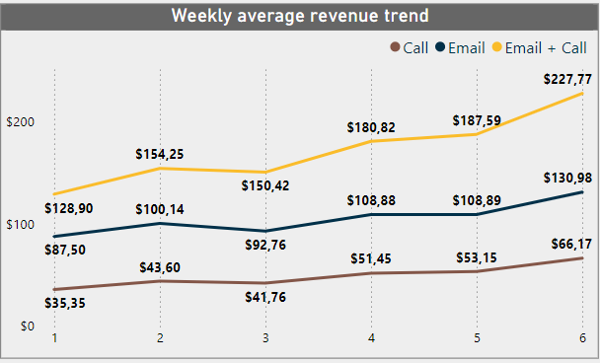
Analysis over time
The total revenue chart reveals Email starting strong but sharply declining, Email + Call rising from the lowest to the highest performer, and Call remaining steady over time.
Average revenue improves across all methods over time within their respective revenue ranges.

Slide 7
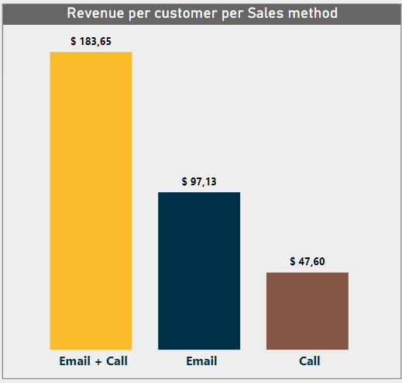
Sales Method Selection Based on Insights
KPI:
Revenue per Customer= Total revenue / Count of Customers
Key Findings:
Email accounted for nearly half of sales and over half of total revenue.
Call made up a third of sales but only one-sixth of revenue.
Sales over $150 were exclusively from Email + Call.
Email + Call significantly outperforms other methods, while Call shows low efficiency with minimal revenue per customer.
Call method's high time demands and low revenue per sale suggest discontinuing its use.
Focus on Email + Call to maximize revenue as follow-up calls are likely to enhance sales outcomes.

Slide 8
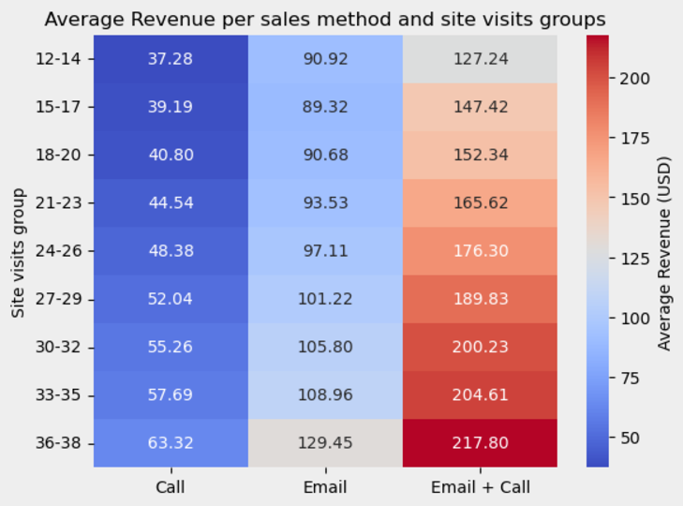
Recommendations and Next Steps
Prioritize Email + Call Method: Discontinue the Call method due to inefficiency and low revenue relative to time investment.
Adopt Revenue per Customer as Key Metric: Use revenue per customer to evaluate and monitor the new product line's performance.Focus future campaigns on maximizing this metric.
Enhance Data Collection: Include data on contacted customers, not just those who made purchases. Enable deeper analysis, including conversion rate calculations.
a
b
c
Drive Customer Engagement Through Marketing: Implement targeted campaigns to increase site visits. Heatmap analysis shows revenue growth as visits increase. Encouraging more frequent visits boosts revenue across all methods.

Slide 9
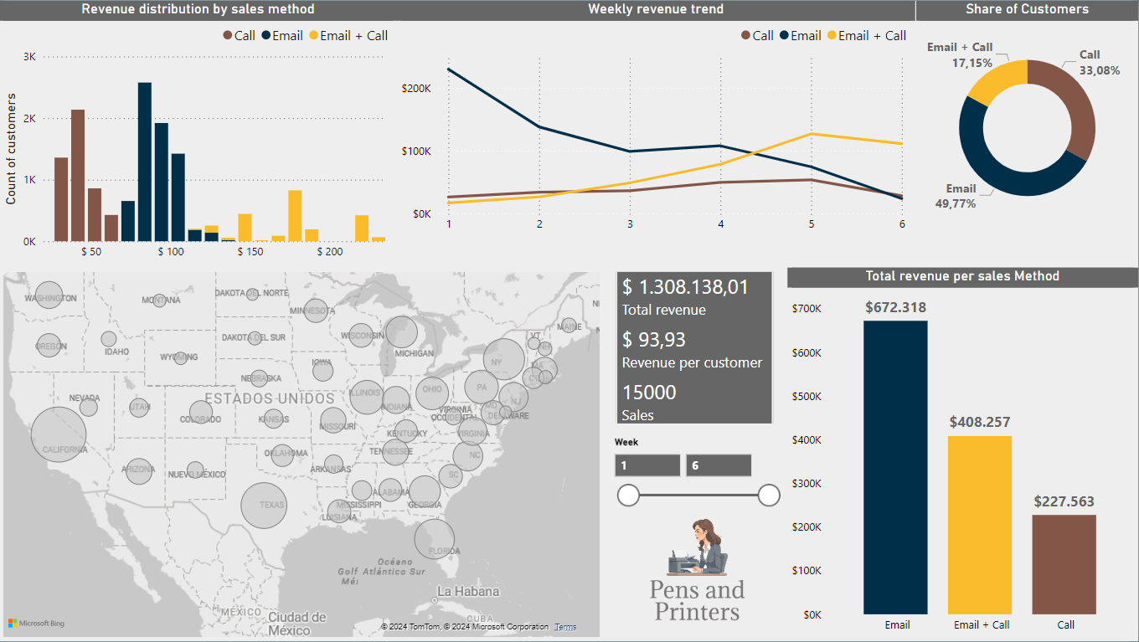
Dashboard

